Slide 1

Staatsbibliothek zu Berlin – PK
Is this really relevant? Browser-based Testing for Enhancing Search results collaboratively
Paterson / Kaufmann
Notes:
Konkreter Eindruck, wie ich damit arbeite; Vorteile / Nachteile

Slide 2

Introduction
Duncan Paterson (duncdrum)
1 year Subject Librarian for Taiwan, Hong Kong, China at day
15+ years of FOSS development and maintenance at night
0.5 years PO for CrossAsia Search (launch 2024) of Specialised Information Service Asia (FID Asien)
One of three productive instances at Stabi Berlin
Annette Kaufmann (annekauf)
25 years librarian, mostly at Staatsbibliothek zu Berlin in various capacities
1 year dabbling in Git and Cypress

Slide 3

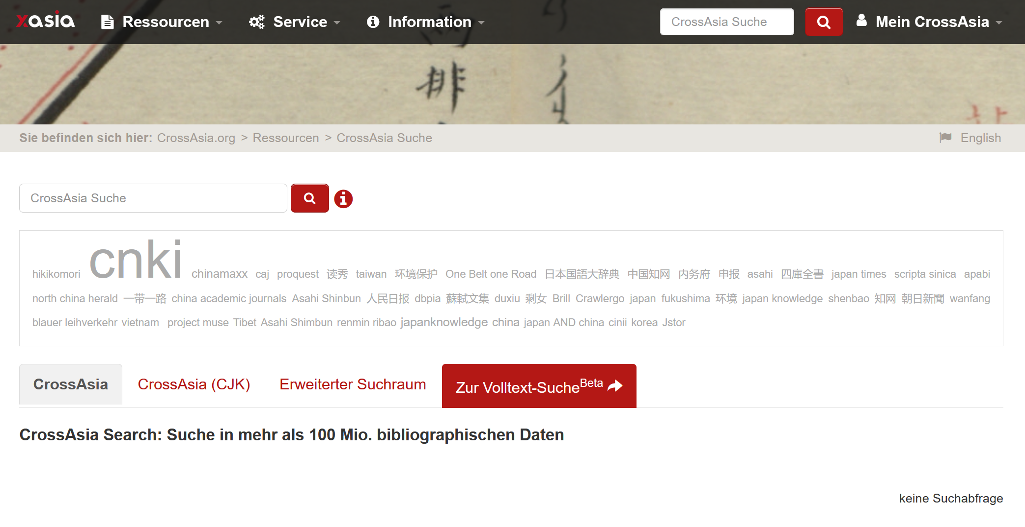

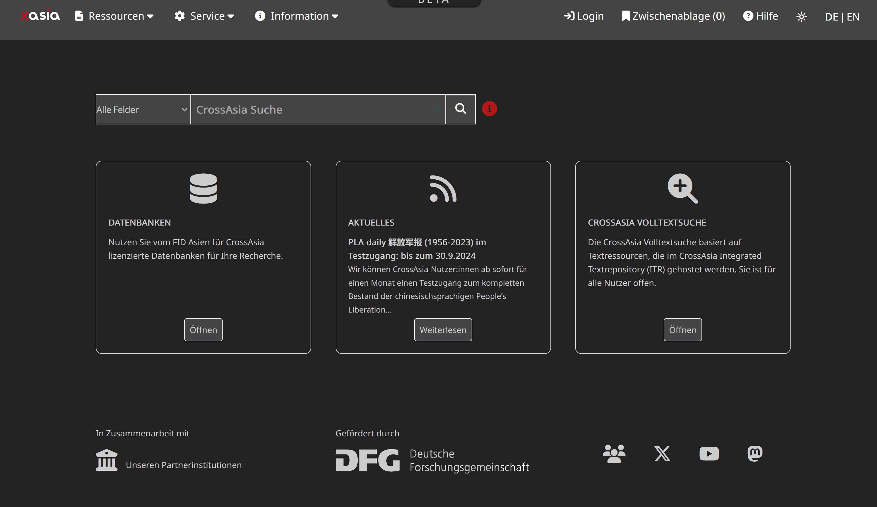
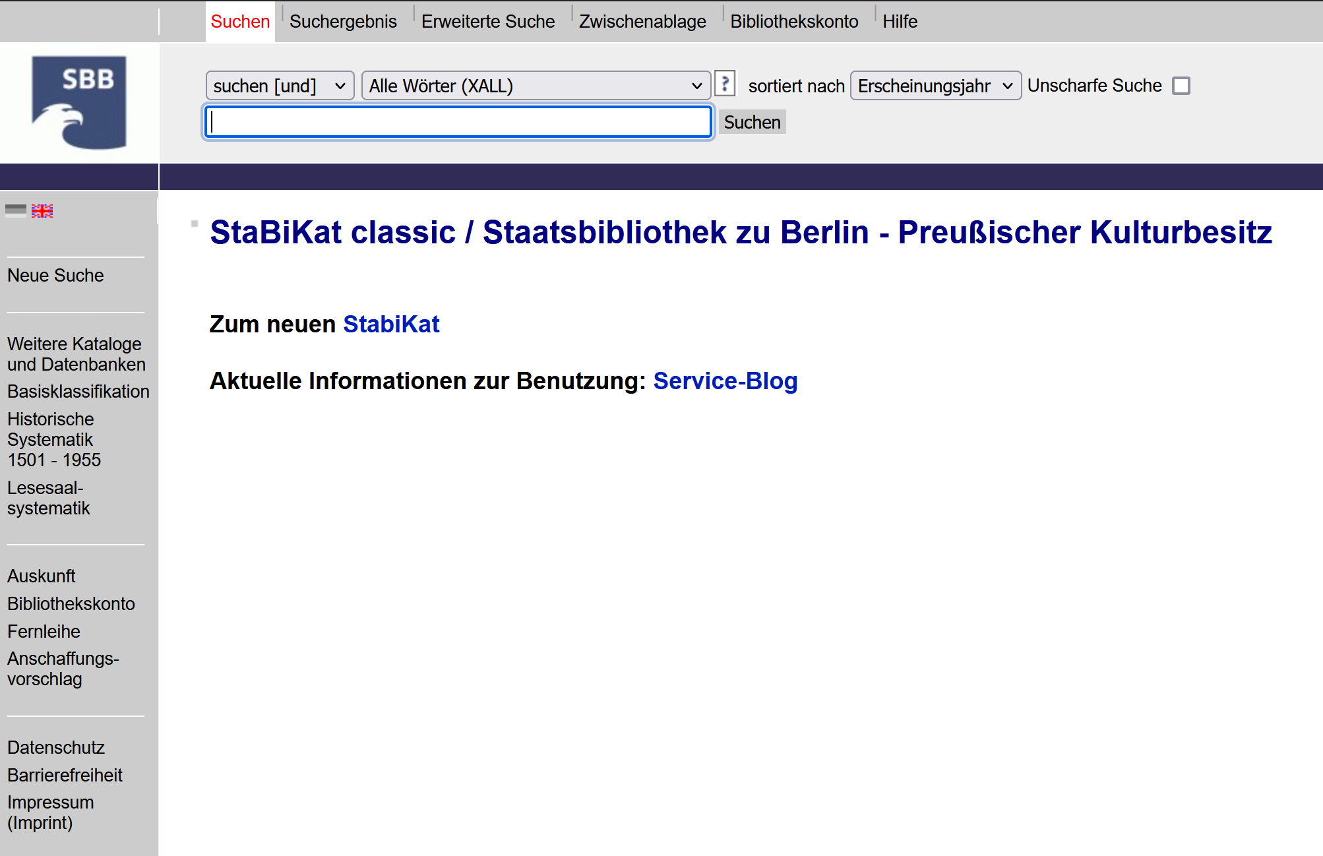
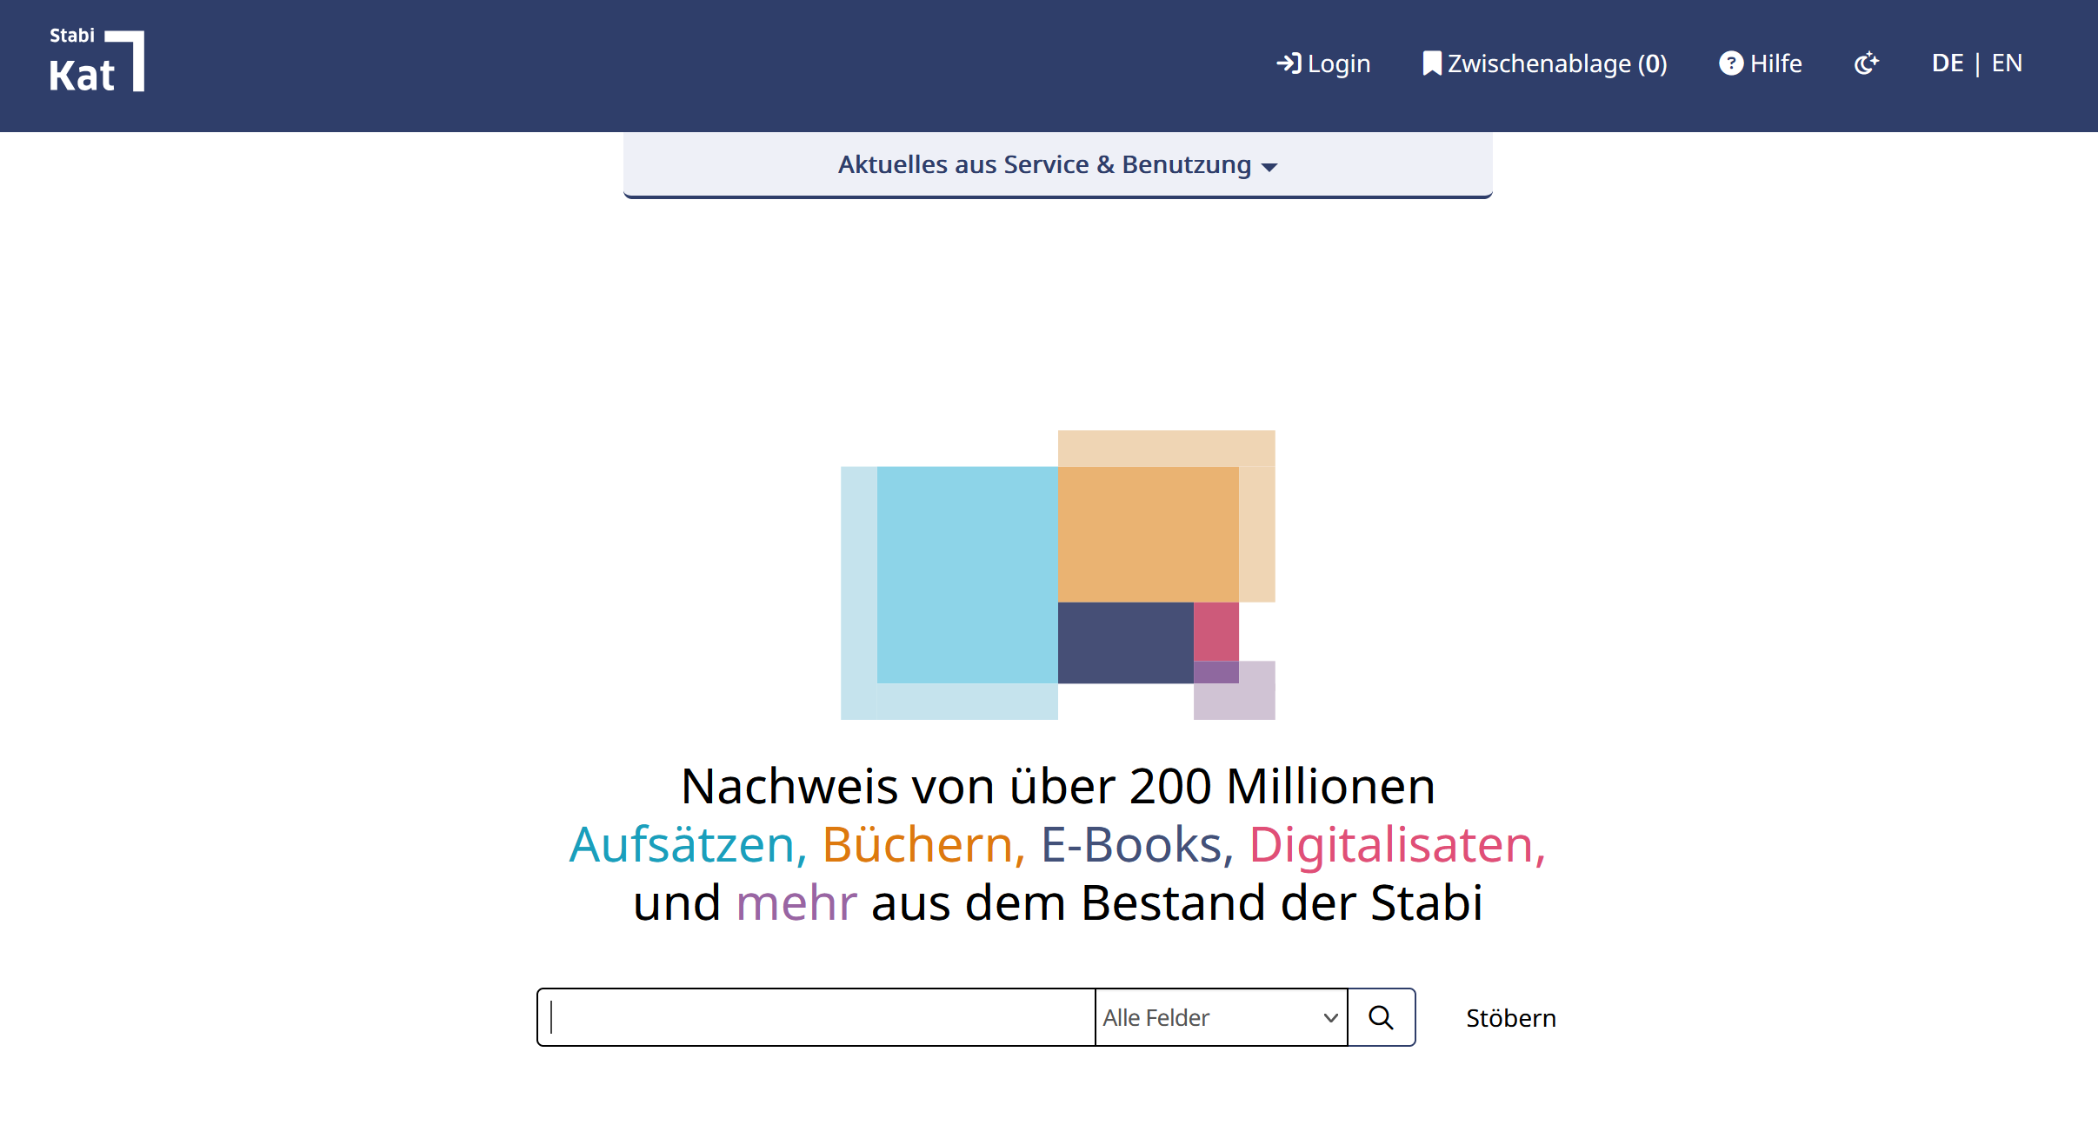
How did we get here?
Notes:
Its 2024 and both for our users there is new stuff lots of it

Slide 4

… they worked without a glitch…
Where is my stuff ¡?
You can‘t test this, cause users have to use a mouse
The old system showed different results
… everybody happy
I can’t find articles
Too many articles
This is different
Notes:
Not talking about inherent biases of relevancy rankings or some such

Slide 5
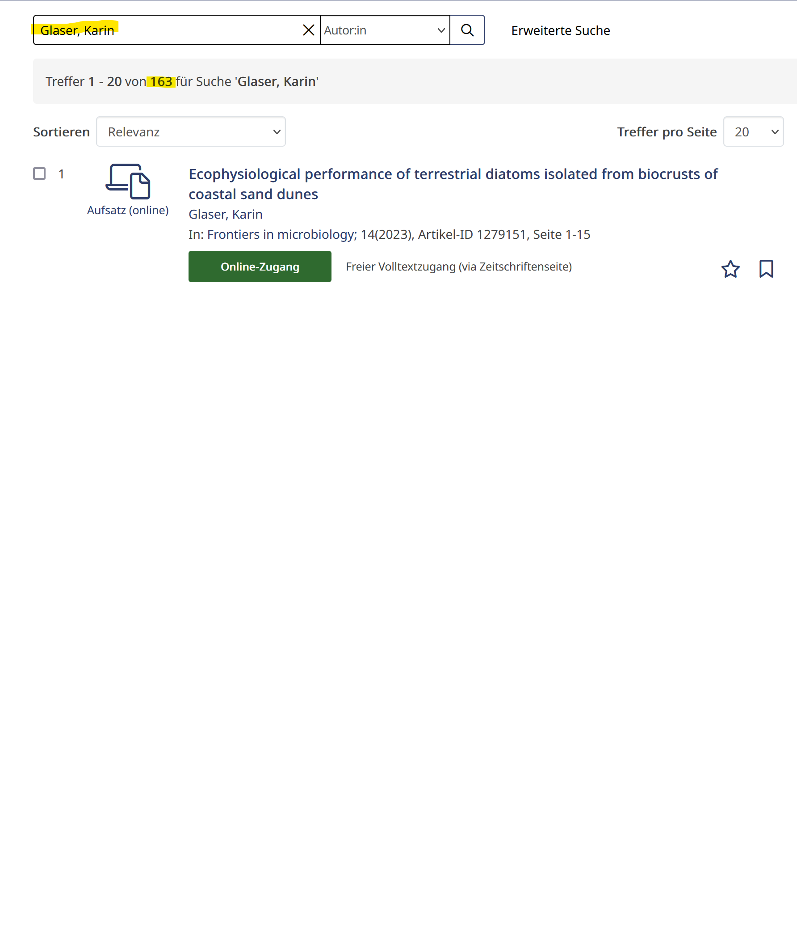
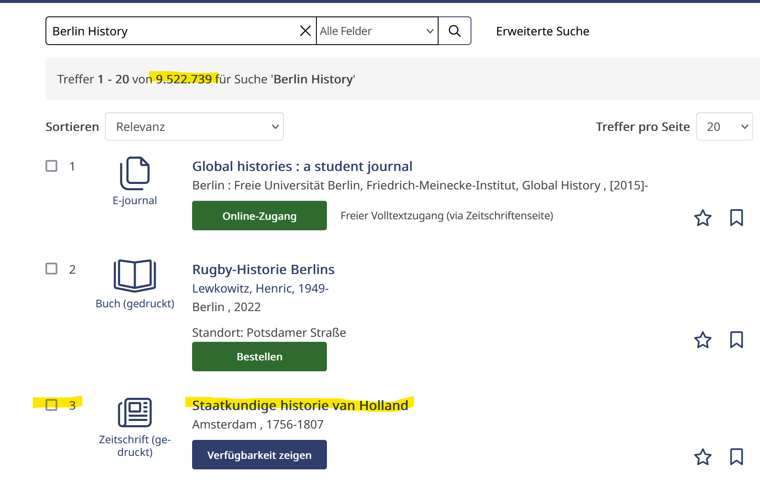

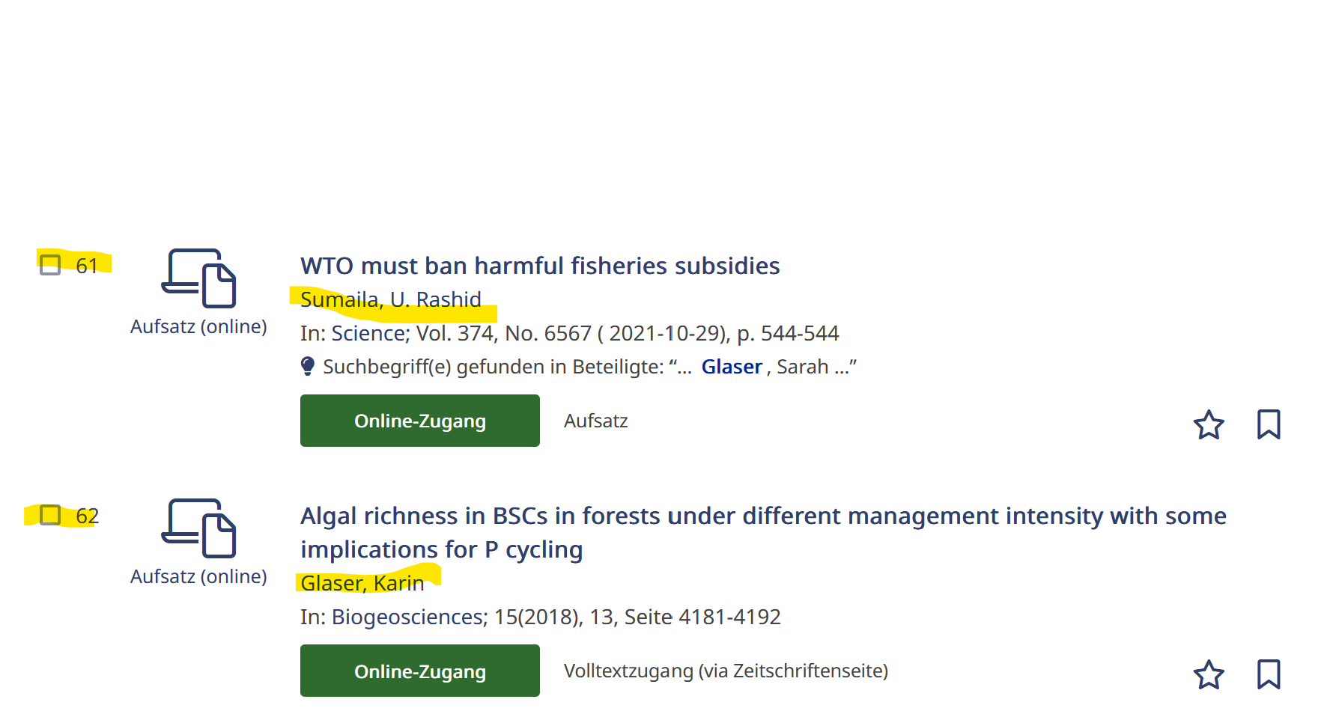
Our users should find stuff
Notes:
It it isn’t on page one it doesn’t exist
Actually Glaser as TOP1 is already the result of the process

Slide 6


The Environment
Data
Discovery
Index
Legacy Data
Heterogenous Sources
Costly changes
Three instances
Many stakeholders
Reader Services, IT, Infrastructure, East Asia, Law …
Easy to tweak
Collaborative Index K 10 Plus
Configuration not under our control
☒
🗹
☒
Notes:
The enviroment

Slide 7


Plans A and B
Alone by hand,
Or with a little help
Notes:
Relevancy based ranking is here, let’s fix it either:

Slide 8

Goals
End the folder madness
Create an open and transparent process
If there is a strategy make sure its documented
Avoid loop of regressions by incremental improvements
Make side-effects visible
Improve communication
Notes:
(from heartfelt opinion, to reproducible sample)
Not ”it was better” but “what was better, how so, and how do you know”

Slide 9

Design Principles
GUI whenever possible (GitHub Desktop, Cypress in browser, FileZilla)
Automate as much as possible (linting, CRON run against prod)
Open format (GitHub)
simplicity >> performance
Keep
IT
Super
Simple
Notes:
Keep it super simple
Its not a unit test
Its not an integration test
We could have pushed it with tighter integration, but alas…

Slide 10
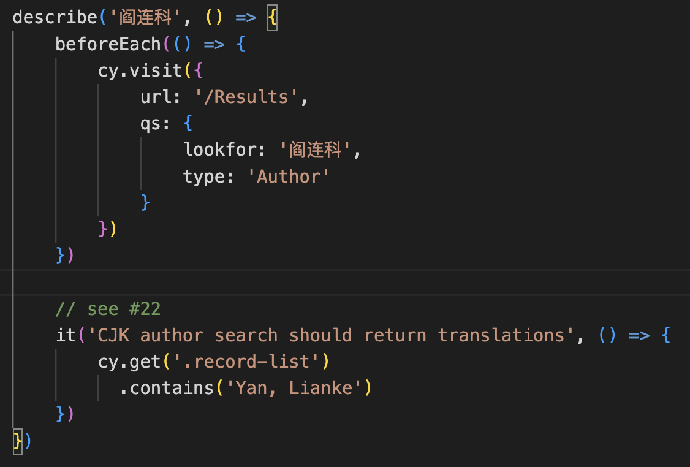
JavaScript is highly overrated
three test templates cover over 80 % of cases
X should / should not exist in result list
String should appear in list items
X appears before Y
Notes:
Copy Paste FTW

Slide 11
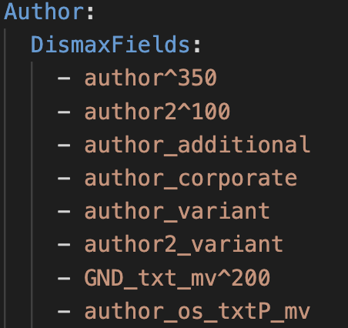
So is Lucene
80% of the time missing index fields, or adjusting boosts achieves the desired outcome
Notes:
In the remaining 20% it gets as complex as you want it to

Slide 12
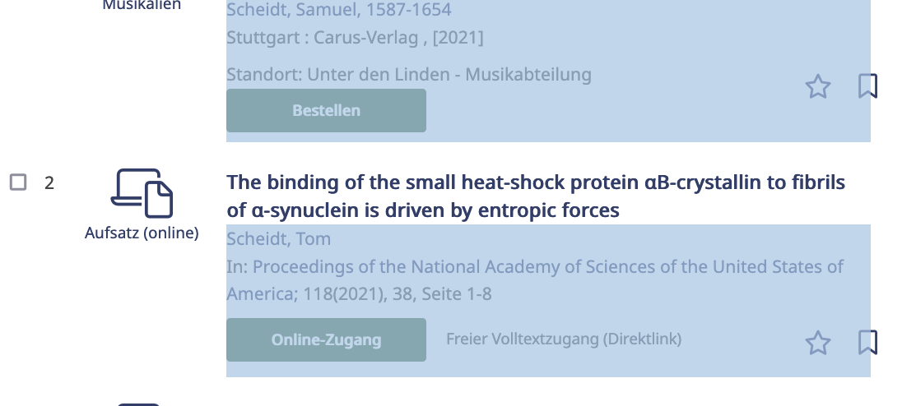
Or the DOM
Three attributes for easier test authoring
.data-id ”visible” in collapsed result-list
.resultlist-data ”as separate from
.record-list .
Notes:
In the remaining 20% it gets as complex as you want it to

Slide 13

Learnings
Biggest issues are set-up and installation
Not everybody likes reproducibility
Any error is a showstopper
Translating opinion into assertions is difficult
Initial effort has resulted in real progress
Good enough can be hard to accept
Reconsider the use of dictionary words when creating your pseudonym / naming your child
Notes:
Node
Browser automation prohibition
Once it runs it runs
Roman Herzog

Slide 14
Lastly…
Relation between query language and language of result
ToCs can make things worse
Users
Domain Experts
Developers
Reviews are tricky
Every search mode counts
chronology
Notes:
User expectation is not always justified let alone representative (intention also not clear from the logs)
Domain experts aren’t normal users, but they know what there and can make judgement calls
Technical quality != content quality
Search mode despite low usage

Slide 15


Working With Git and Cypress for the First Time (as a Librarian): This is awesome!
don‘t have to do it all alone!
I can actually see (side) effects!
can travel back and forth in time!
all versions of yaml are safe!
this is all very exiting!
"Rudi ist begeistert" by stanzebla is licensed under CC BY-SA 2.0.
Notes:
Alone meaning: run 80 search queries manually and compare all (!!!) of the result lists to see what has changed and check for side effects. The complexity is baffling (at least to me)
Versionizing the yaml and how to handle it was an unsolved issue: only idea was saving the yaml after each change….. Which I‘m aware probably sounds ludicrous to this audience….
Plus I was really eager to enter the mysterious realm of Git and kinda „graduate“ to more developer-like work process.

Slide 16
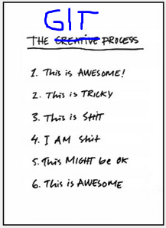

Test-Driven Development as a Newbie (and Librarian): This is Tricky IT Stuff
The biggie Git: getting my head around workflow and branches-multiverse; getting lost time and again
Cypress: wait, what? Reading and interpreting test failures
Notes:
Circling through the stages (see right) on a regular basis
Message: if you‘re an administrator you need to support getting started and teach Git; and permanent support;

Slide 17



Test-Driven Development as (a Newbie) and Librarian: This is … … hard Culture Clash
formalizing requirements
iterative progress
trust the process?
facts are hard, opinions are easy
"Good versus Evil" by kosmolaut is licensed under CC BY 2.0.
Notes:
manual searches and interpretation of hit lists : personal, „intellecutal“, seems more „hands-on“, controllable, reproducible and traceable – it‘s what librarians are used to.
Automated tests and looking at green checks and red crosses by comparison seems technocratic, like loss of control and kind of externalised. I don‘t feel there‘s trust in the tests doing their job
While in effect it‘s the other way round. Failure to get across the advantages, nay: the NECESSITY for test-based ranking development: 82 search queries
Side effects seem not to be differentiated from work to fulfill ranking demands.
automated tests versus manual searches
test results versus interpretation of hit lists
Big Issue: Präzisierung: Anforderung; Reproducible (-> Duncan)

Slide 18
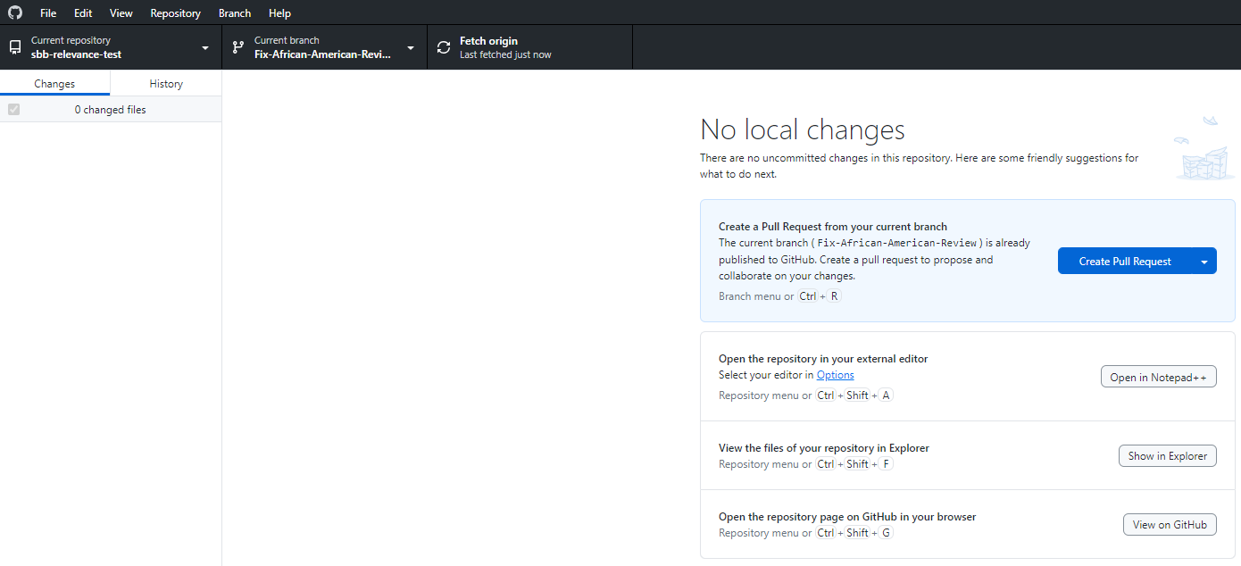
Working With Git and Cypress for the First Time (as a Librarian): I am … … challenged…

Slide 19
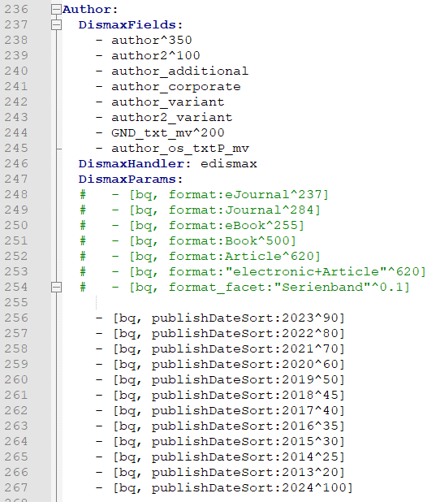
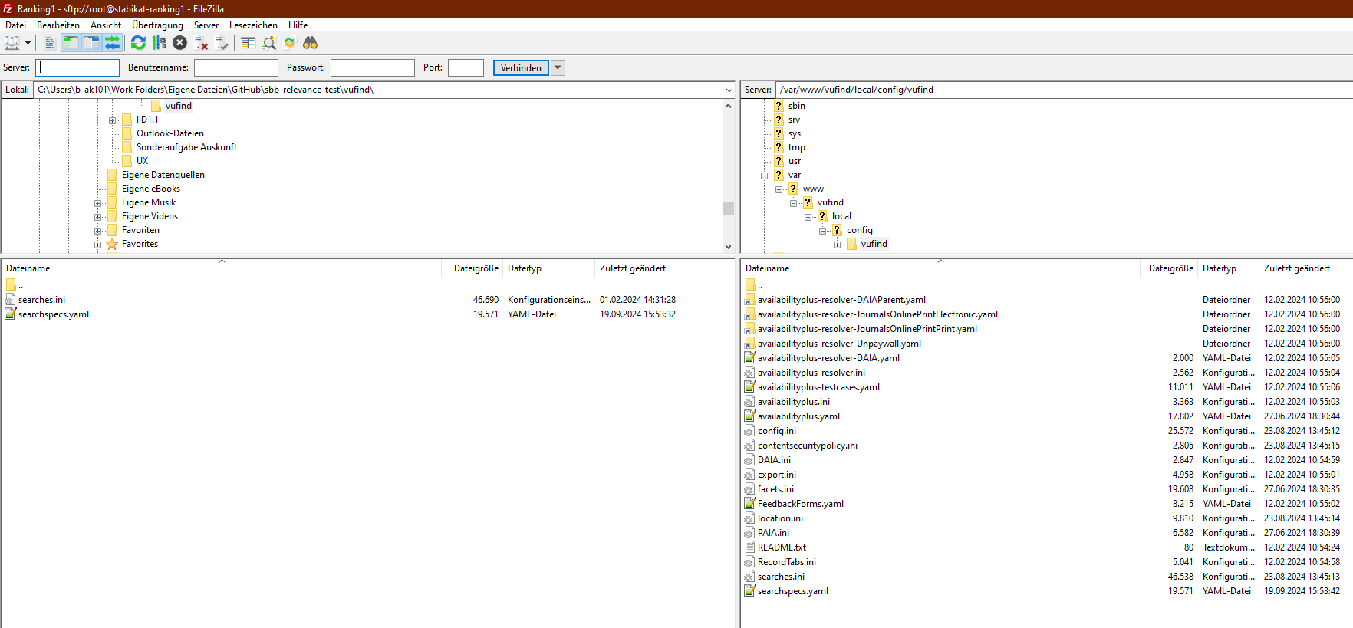
Working With Git and Cypress for the First Time (as a Librarian): I am … … sometimes confused….

Slide 20
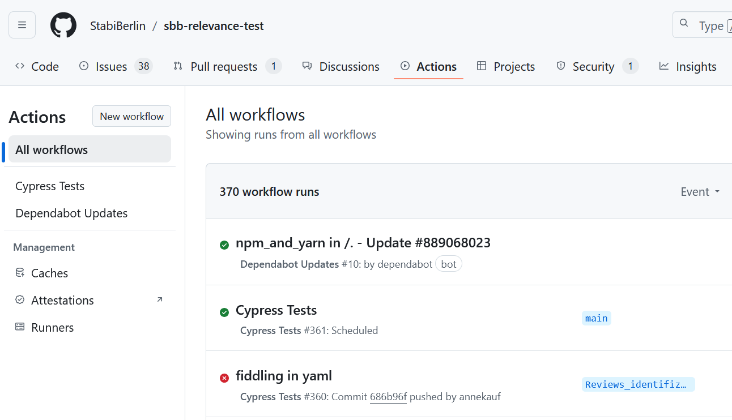
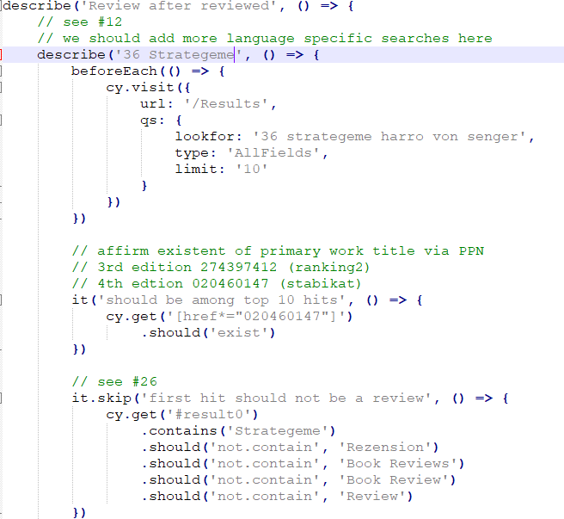
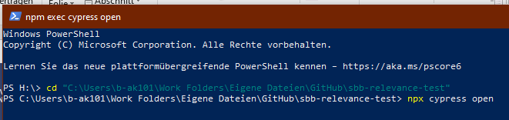
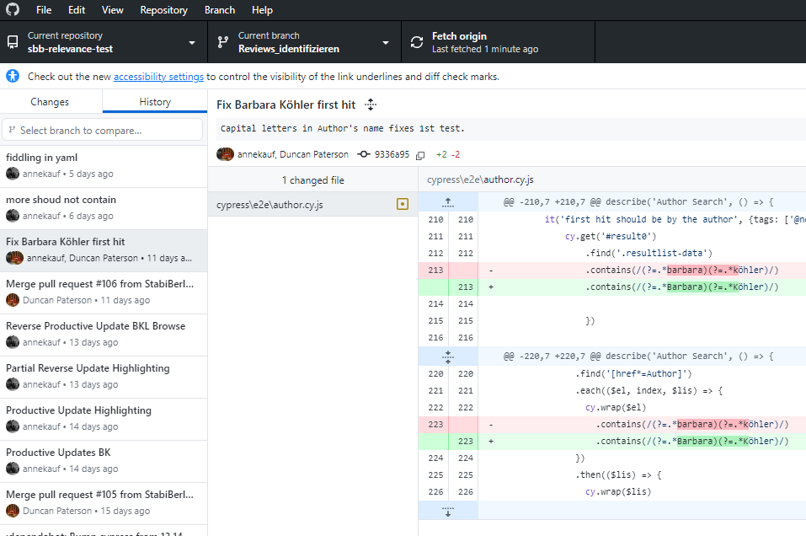
Working With Git and Cypress for the First Time (as a Librarian): I am … … working….

Slide 21
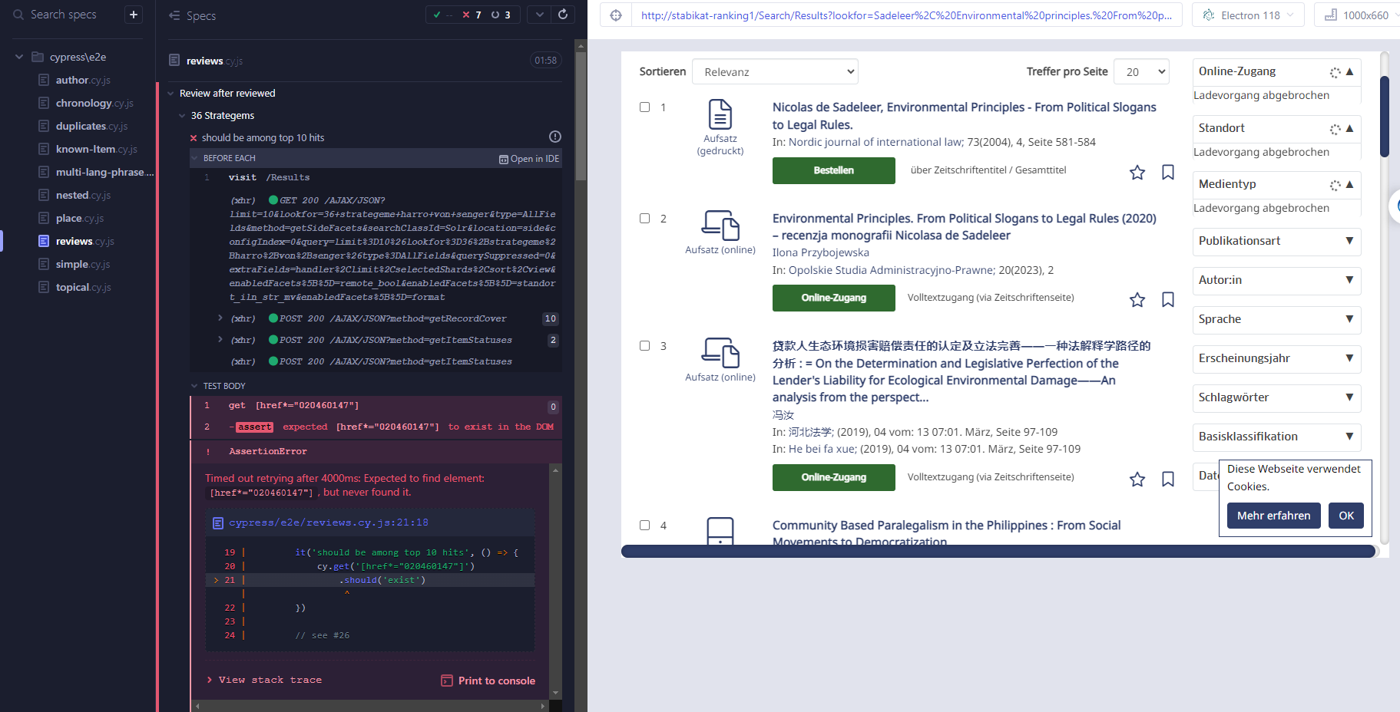
Working With Git and Cypress for the First Time (as a Librarian): I am … … confused

Slide 22
Working With Git and Cypress for the First Time (as a Librarian): I am … … challenged

Slide 23

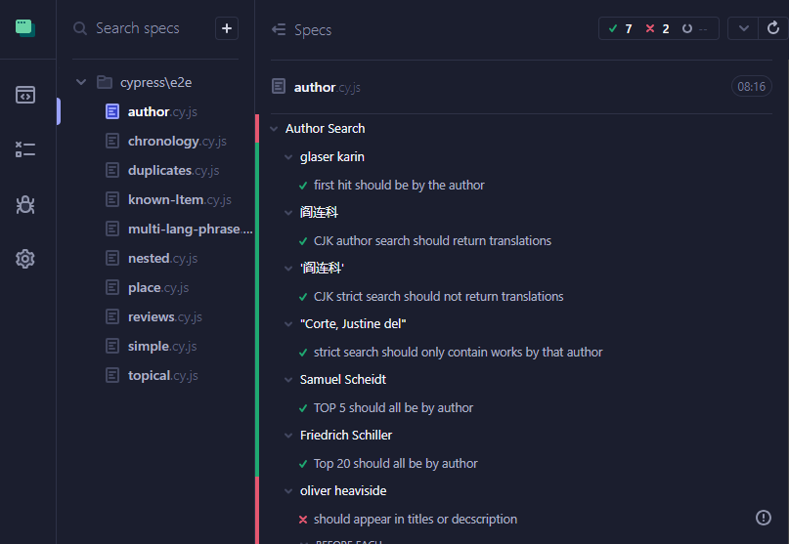
Working With Git and Cypress for the First Time (as a Librarian): I am … … a bit overwhelmed
"Shock Shock Horror Horror" by Jeremy Brooks is licensed under CC BY-NC 2.0.

Slide 24
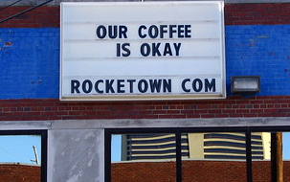
Test-Driven Development as a Newbie (and Librarian): This Might be Okay
managing expectations: what yaml can and can‘t solve re: VuFind result list
getting to grips with Git (more or less)
explaining work process to colleagues
„comes at a price“
there‘s no such thing as a perfect yaml = perfect ranking
"Our Coffee is Okay" by SeeMidTN.com (aka Brent) is licensed under CC BY-NC 2.0.
Notes:
Yaml can‘t solve duplicate problems; can‘t solve „wrong authors“ in result list („Barbara Köhler“) ; hard to have chronology ranking and at the same time disciminate reviews (Review problem / UX)
Comes at a price:
yaml is not a jack-of-all-trades device; conflicting demands (s. above) may not be able to be both met
The goal and result can only ever be an okay yaml (difficult for perfectionists to accept)

Slide 25
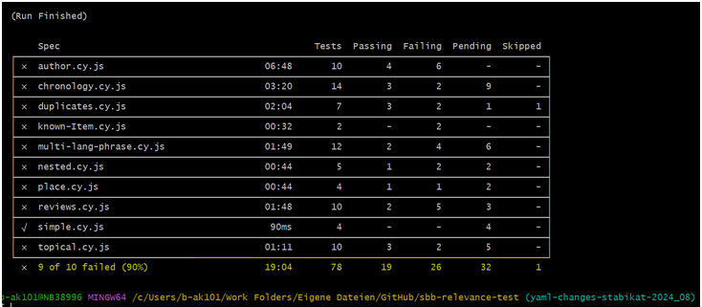
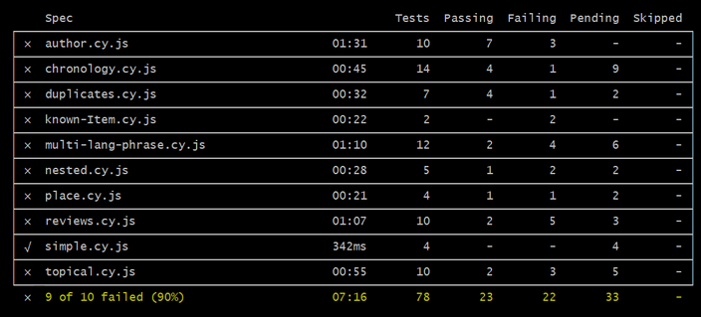

Slide 26
Working With Git and Cypress for the First Time (as a Librarian): This is awesome!
have learned so much!
travel back and forth in time!
all versions of yaml are safe!
can actually see (side) effects!
track progress (accurately)
Clear definition of goal
Collaborative yaml-work is easy!
"Rudi ist begeistert" by stanzebla is licensed under CC BY-SA 2.0.
Notes:
New on this slide:
track progress
Clear definition of goal
-> progress: more green tests
-> clear goal: all tests are green
This all gives security and clarity
Collaborative work is easy – now many people could work on improving yaml-ranking

Slide 27

The Frontier (to be pushed forward in the future?)
Git makes stuff clear: decision is in main - this doesn‘t translate into library management structure
how to integrate CICD practices into librarians everyday work
evolution from Excell-sheet to world-wide publication: transparency is scary
discovery system users become contributor/contributress
user research-based decisionmaking
"c'era una volta il west.....once upon a time in the west...." by betbele is licensed under CC BY-NC-SA 2.0.

Slide 28
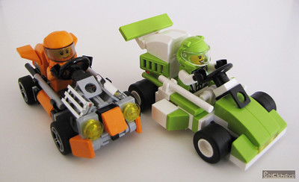
https://github.com/StabiBerlin/sbb-relevance-test
https://stabikat.de
Duncan.paterson@sbb.spk-berlin.de
Annette.kaufmann@sbb.spk-berlin.de
"Microkarts: Orange versus Lime" by Bricknave is licensed under CC BY-NC-ND 2.0.

